Slide 1
A novel modeling to generate alternatives approach
Determining the convex hull containing all near optimal solutions
Author: Tim Pedersen
Supervisor: Gorm B. Andresen
Notes:
Which means that I have developed a new modeling to generate alternatives approach that I have used to addressing structural uncertainty in energy system models

Slide 2
Agenda
Motivation
Modelling to generate alternatives
Optimization model
Experiment results
Conclusion

Slide 3

Motivation
Irreversible climate change
Large share of emissions are from energy production [1]
Wind/Solar implementation
Better models
[1] European Environment Agency. Annual European union greenhouse gas inventory 1990 – 2015 and inventory report 2017. 2017.
https://www.eea.europa.eu/data-and-maps/daviz/ghg-emissions-by-aggregated-sector-2#tab-dashboard-01
Notes:
Pointe: Climate change = need for models

Slide 4
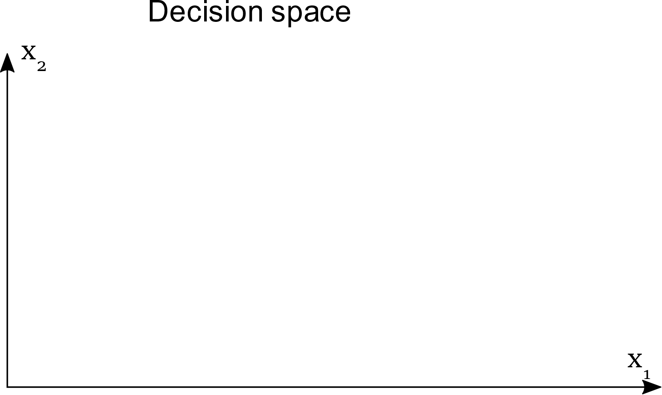
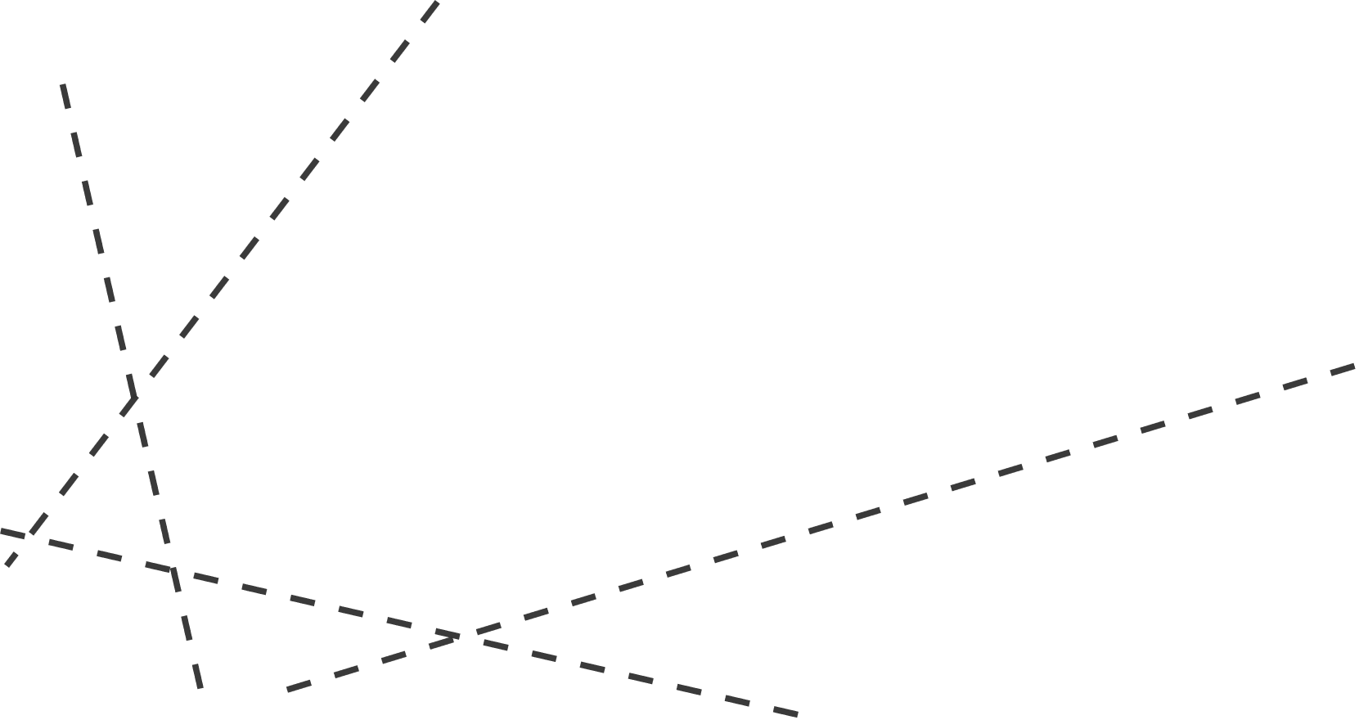
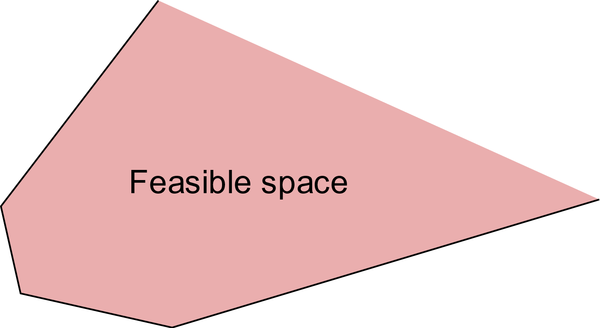
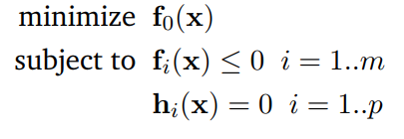
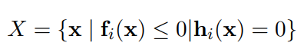
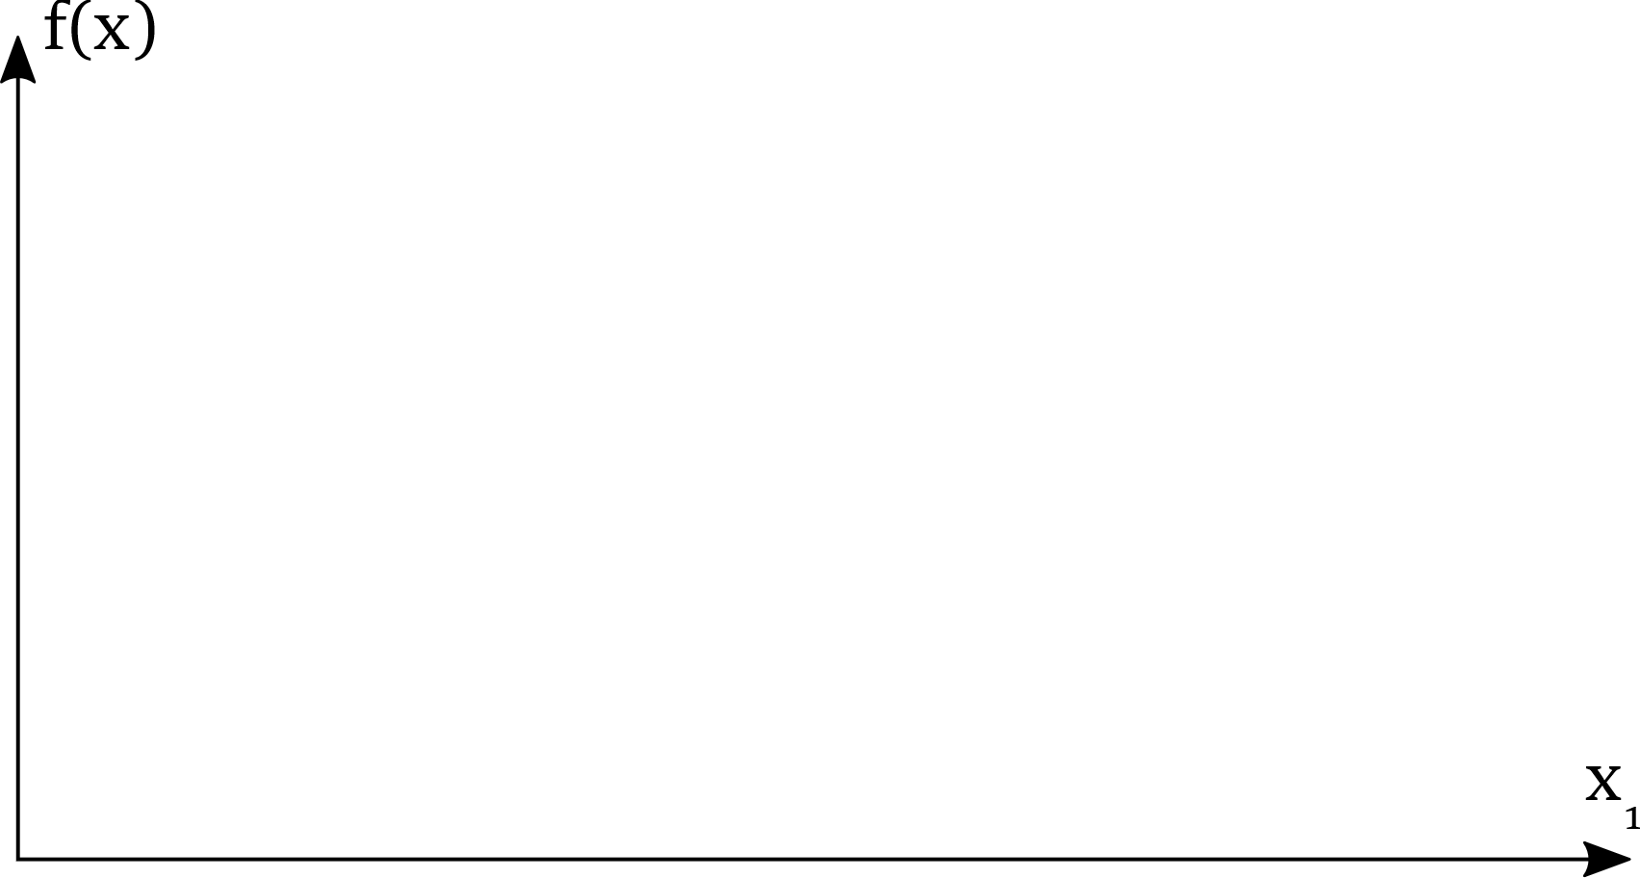
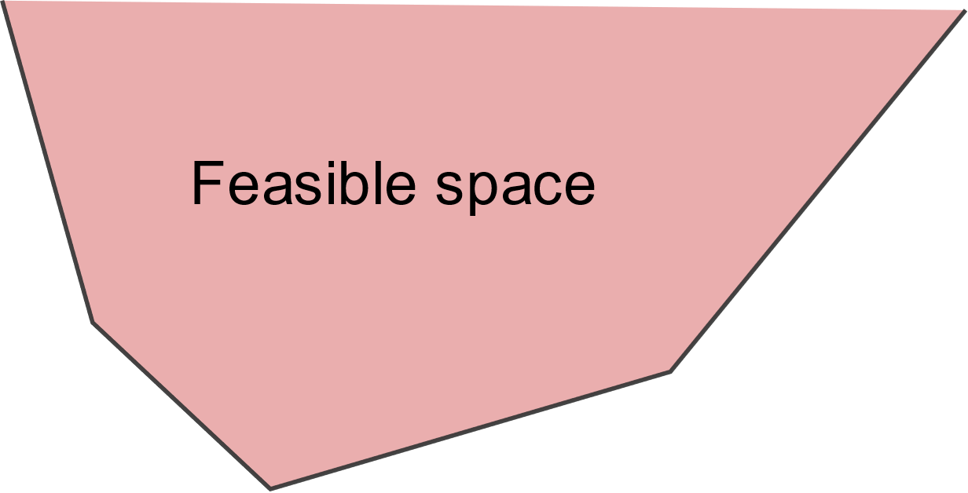

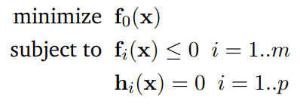
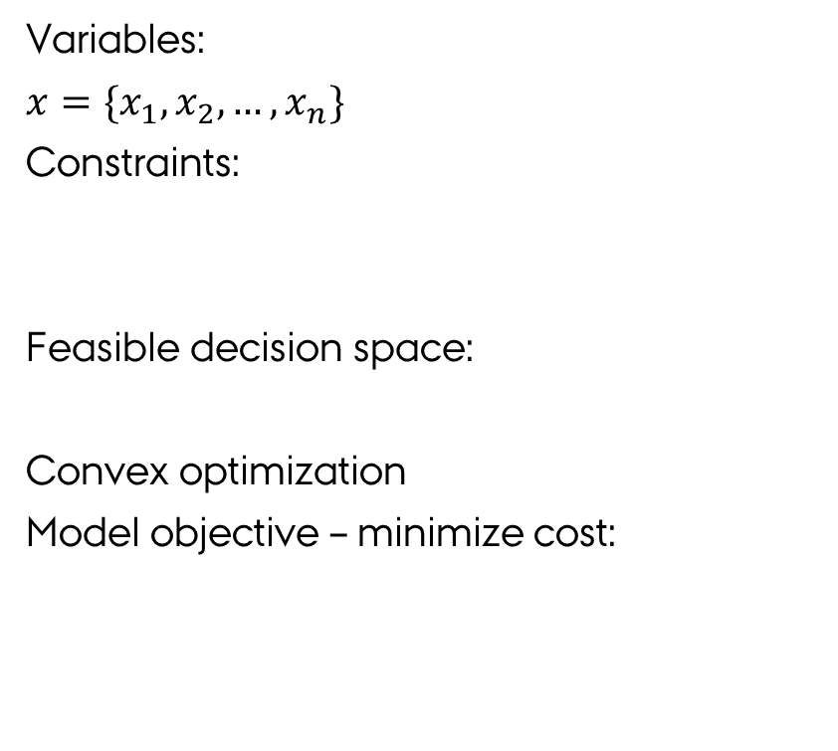
Motivation - model
Variables:
$x=\{x_{1},x_{2}, …, x_{n}\}$
Constraints:
Feasible decision space:
Convex optimization
Model objective – minimize cost:
Optimal solution
Notes:
Pointe: Rough explanation of model

Slide 5
Motivation - model flaws
Parametric uncertainty
Change in weather patterns
Change in energy demand
Unknown technology prices
Structural uncertainty
Unmodeled objectives
Political decisions
Mathematical simplifications
The true solution is just as likely to be located in the near-optimal regions of the decision space. [2]
[2] Lewis D. Hopkins E. Downey Brill Jr., Shoou-Yuh Changt. Modeling to generate alternatives: The hsj approach and an illustration using aproblem in land use planning. Management Science, 28, 31982.
Notes:
Pointe: Structural uncertainty = analyze near optimal region

Slide 6
Objective
Define a method capable of addressing structural uncertainty in techno-economic models, based on the principles of modeling to generate alternatives (MGA).

Slide 7
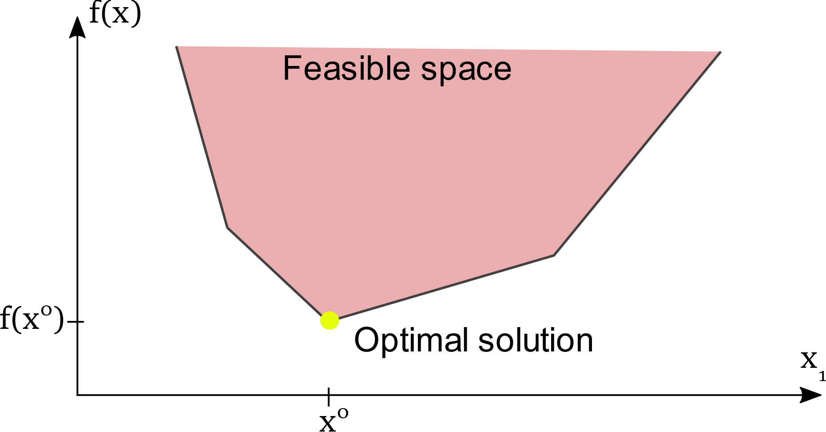
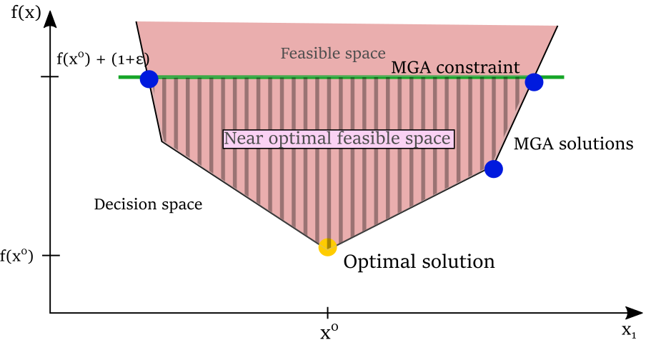
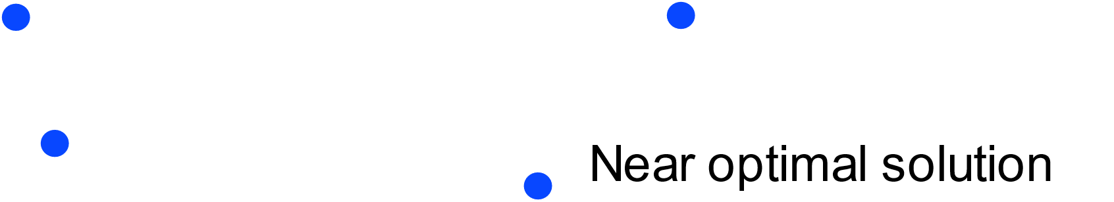
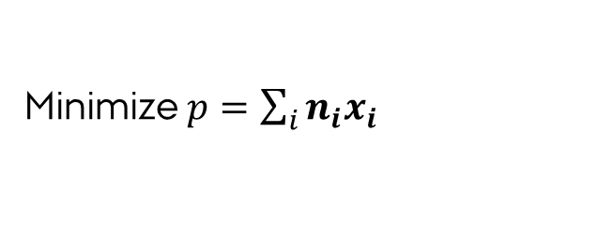

Modeling to generate alternatives
Method to find alternative near optimal feasible solutions
MGA constraint:
New objective function
$$f\left(x\right)<f\left(x^{0}\right)⋅\left(1+ε\right)$$
$ε :$ MGA slack
Near optimal
Feasible space
Minimize $p=\sum_{i}{n_{i}x_{i}}$
Notes:
Pointe: Finite number of points define the entire set

Slide 8
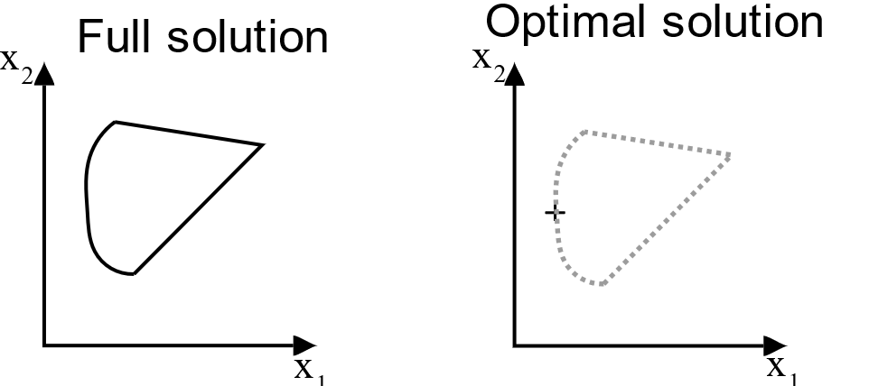
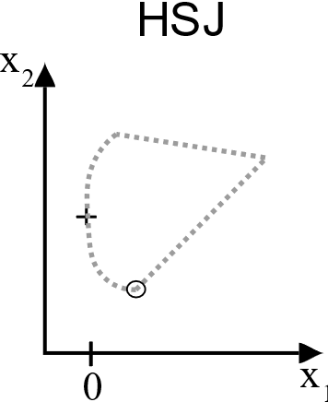
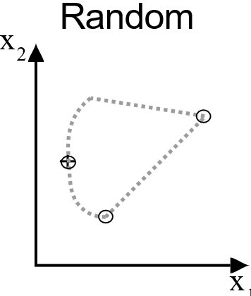
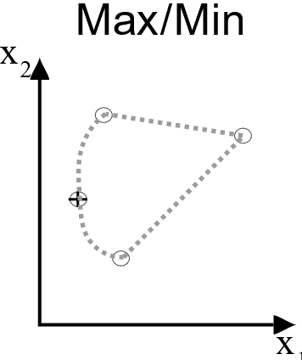
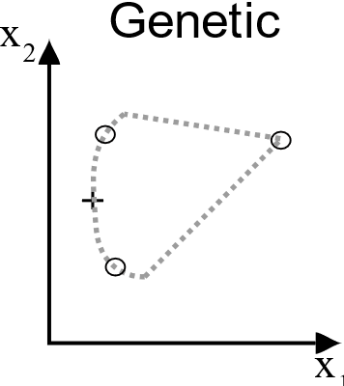
Modeling to generate alternatives
Existing MGA methods
Hop Skip Jump (HSJ) [2]
Minimize all non zero variables
Random search
Maximize/Minimize [3]
Genetic algorithms [4]
Common feature:
Finite number of solutions
[2] E. Downey Brill Jr., Shoou-Yuh Changt, Lewis D. Hopkins . Modeling to generate alternatives: The hsj approach and an illustration using a problem in land use planning. Management Science, 28, 1982.
[3] Fabian Neumann and Tom Brown. The near-optimal feasible space of a renewable power system model, 2019
[4] Daniel H. Loughlin, S. Ranji Ranjithan, E. Downey Brill JR., and John W. Baugh JR. Genetic algorithm approaches for addressing unmodeled objectives in optimization problems. Engineering Optimization, 2001.

Slide 9
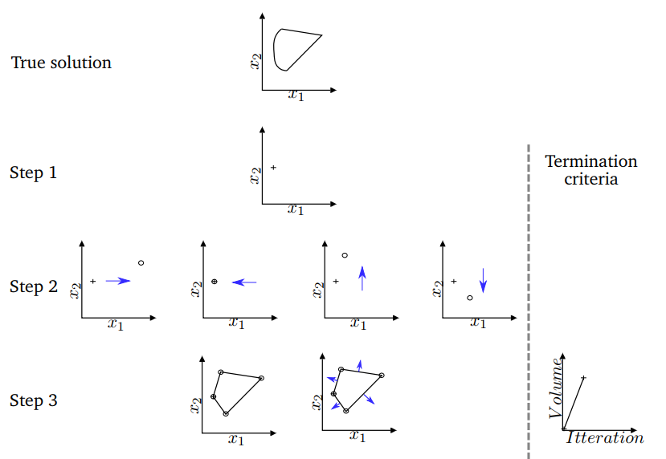
Novel MGA approach
Regular Optimization
Add MGA constraint
Maximize and minimize all variables
Compute the convex hull and determine face normal directions
Notes:
Pointe: Explain novel method

Slide 10
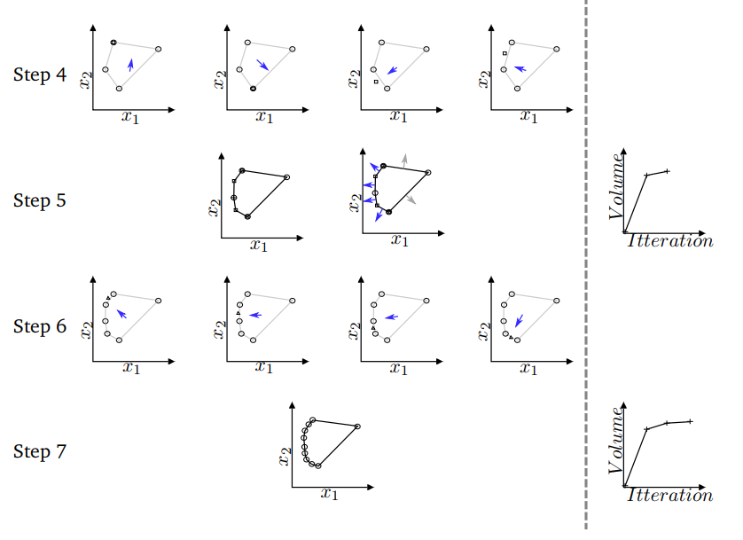
Novel MGA approach
Optimize using face normal directions to determine the objective function
Repeat step 3
(Compute convex hull and determine face normal directions)
Repeat step 4
Terminate algorithm when iteration criterion is reached
Notes:
Pointe: Novel method converges towards full solution + can be expanded to n dimensions

Slide 11
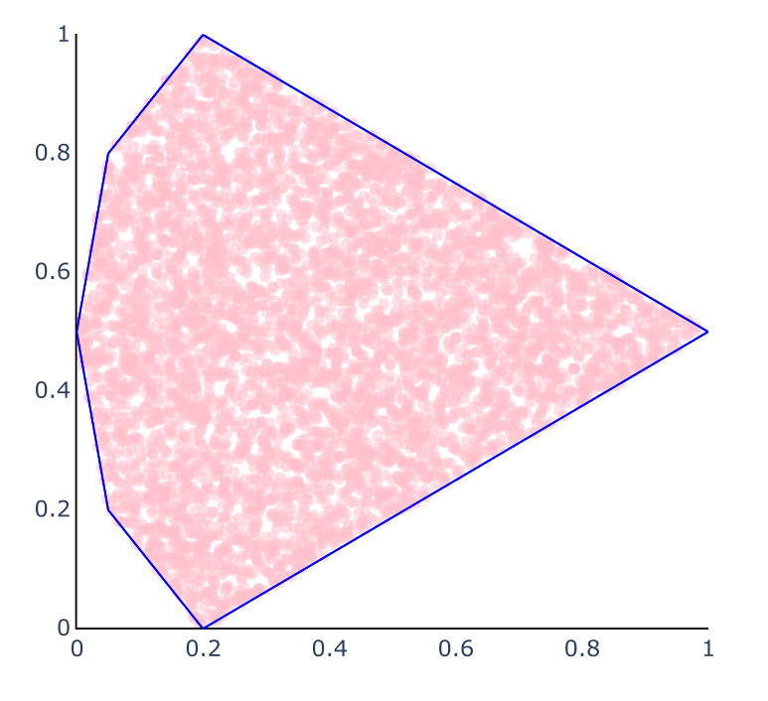
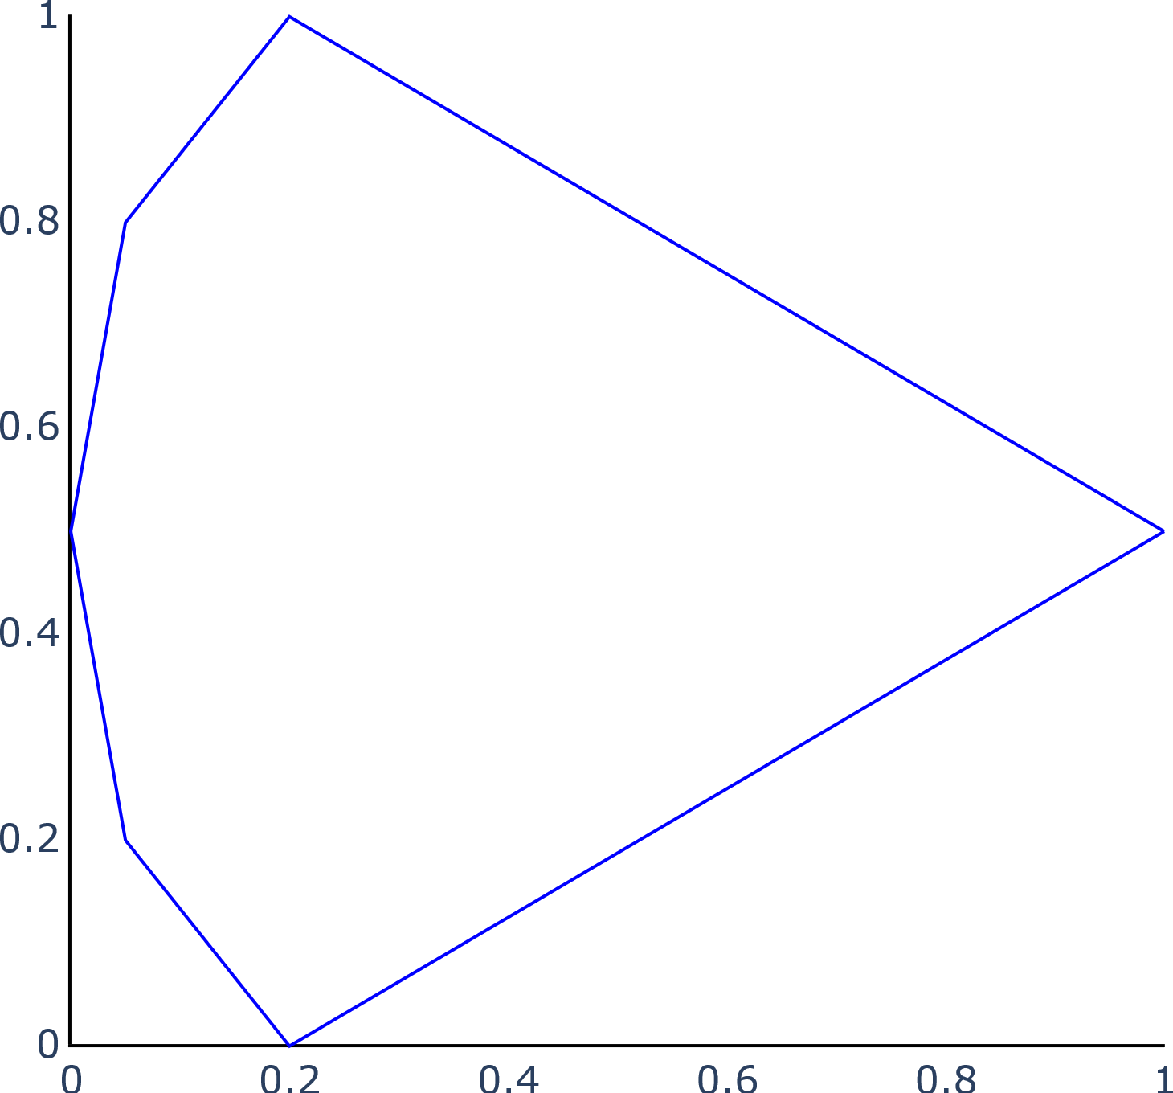
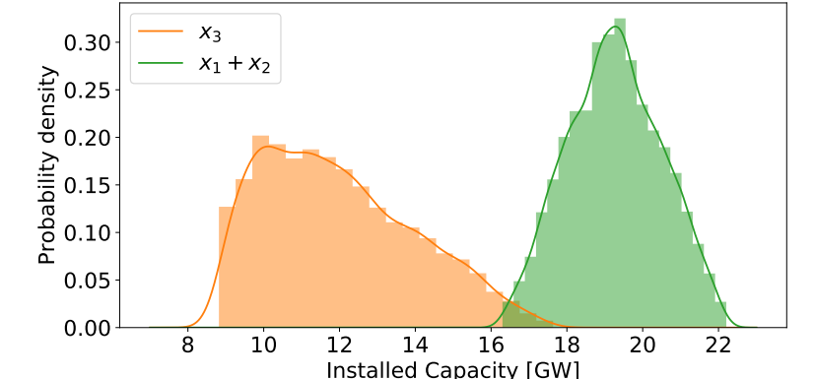
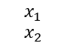
Modeling to generate alternatives
Assuming even distribution
Random sampling across the near optimal feasible space.
Enough points = Full solution
Statistics about all feasible solutions
$$x_{1}$$
$$x_{2}$$
Notes:
Pointe: Sampling to gain statistical data about ALL solutions

Slide 12
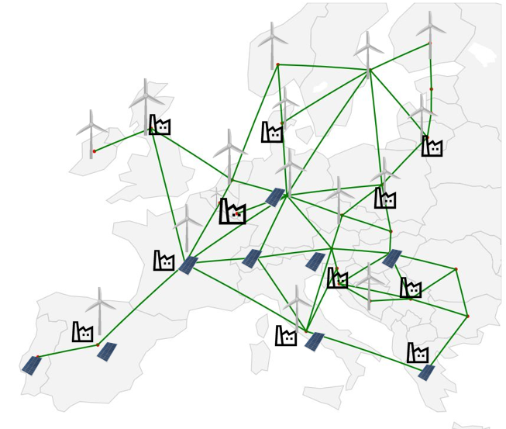
Model
Electricity grid of 30 European countries [5]
Variables:
Generator capacities (Wind, Solar, Gas)
Transmission line capacities
Hourly energy production
Hourly energy transmission
Constants:
Demand
Capacity factors
Technology cost
[5] D.P. Schlachtberger, T. Brown, S. Schramm, and M. Greiner. The benefits of cooperation in a highly renewable european electricity network. Energy, 134:469– 481, 2017.
Notes:
Pointe: Model serves as a framework to establish usefulness of the developed method
Simplified by reducing number of technologies

Slide 13
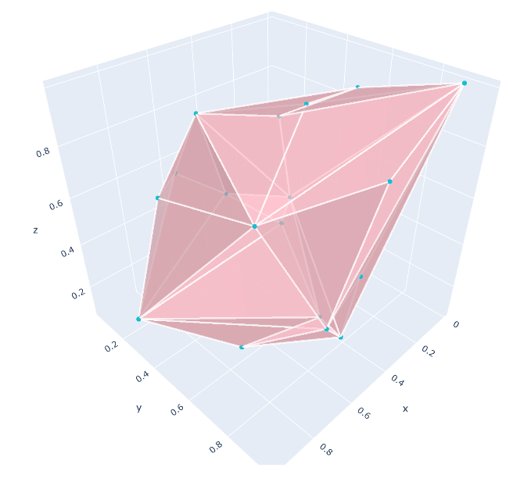
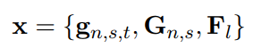
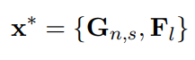
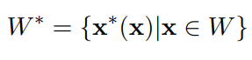
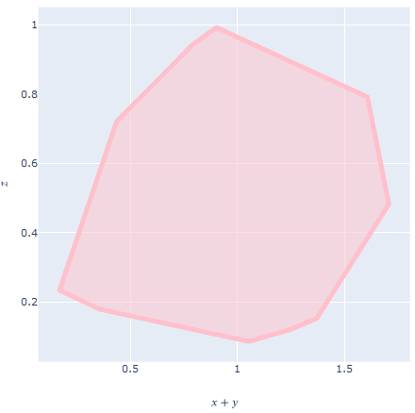
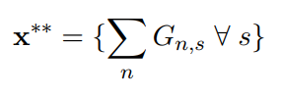
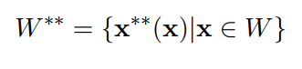
Model – Reducing Dimensions
d ≈700.000
Neglecting hourly energy dispatch
d ≈ 90
Grouping variables by technology
d ≈ 3-10
Notes:
Pointe: Too many dimensions – Reduction methdod

Slide 14
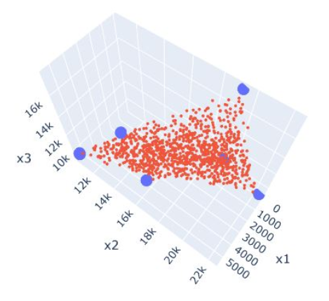
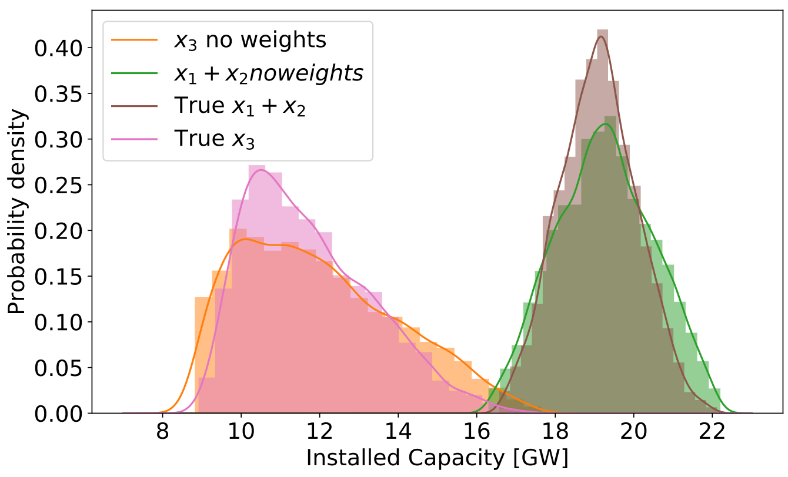
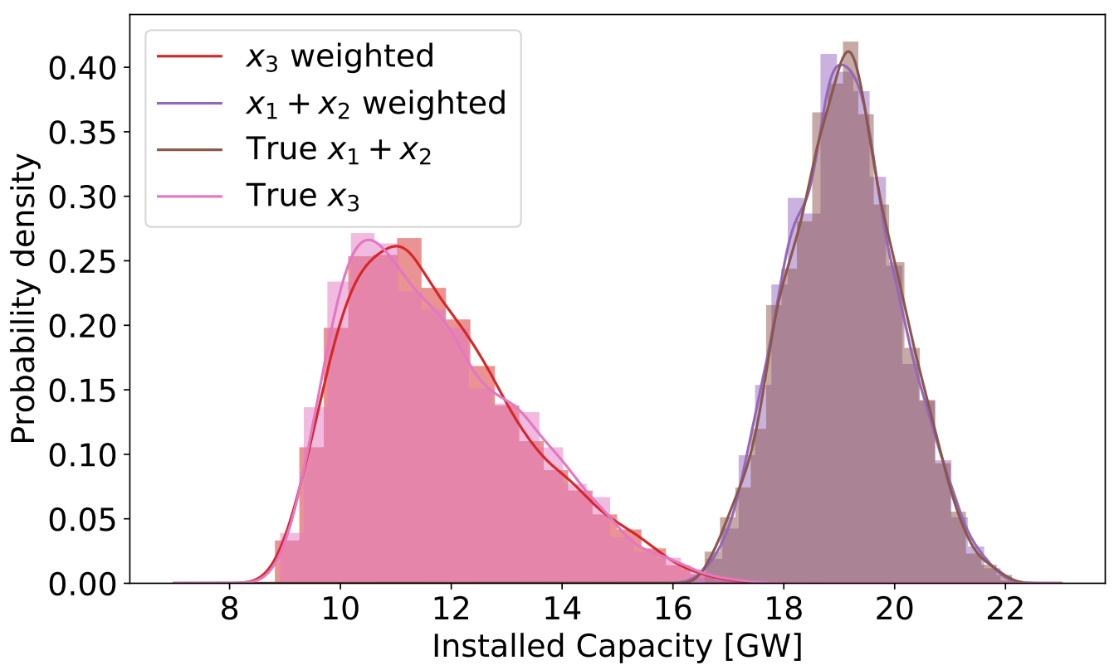
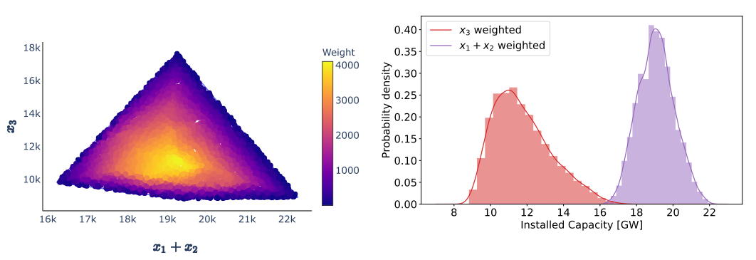
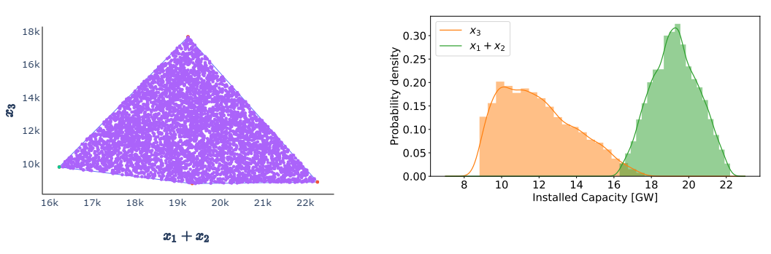
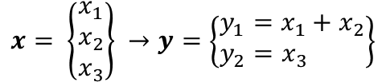
Model - Multiplicity
Reducing dimensions = Reducing information
Full decision space:
1 Point = 1 solution
Reduced decision space:
1 Point = Range of solutions
$$x= \left\{\begin{matrix}x_{1} \\ x_{2} \\ x_{3}\end{matrix}\right\} →y=\left\{\begin{matrix}y_{1}=x_{1}+x_{2} \\ y_{2}=x_{3 } \end{matrix}\right\}$$
Notes:
Pointe: Assumption about equal distribution doesn't hold

Slide 15
Experiment
Euro-30 model
PyPSA [6]
PRIME cluster computer
Parallel processing
4 Variables (Wind, Solar, Gas, Transmission)
7 Variables (Capacities North Europe, Capacities South Europe, Transmission)
[6] Tom Brown, Jonas Horsch, and David Schlachtberger. Python for power system analysis (pypsa) version 0.14.1. https://doi.org/10.5281/zenodo.3233682, may 2019

Slide 16
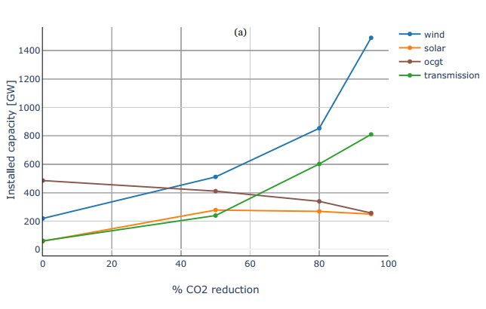
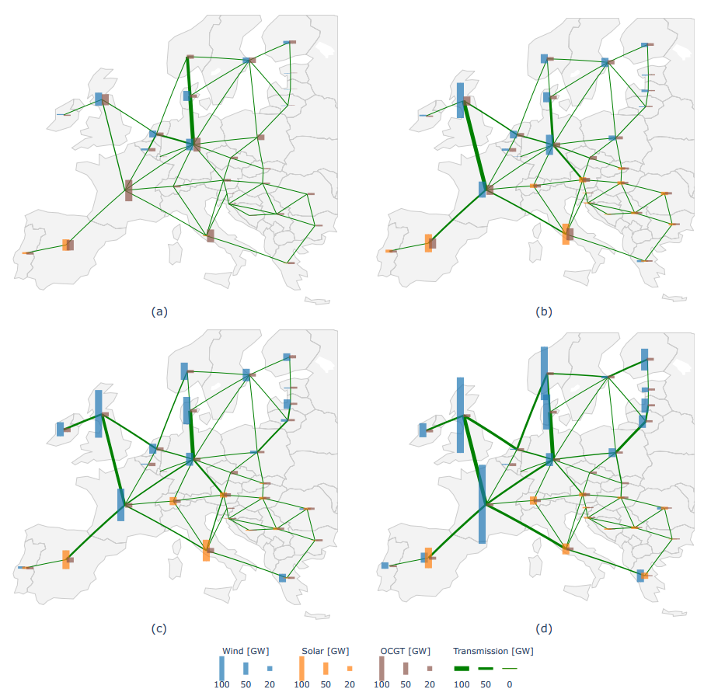
Results - Optimal solutions
CO2 reduction levels:
0, 50, 80, 95% reduction
Notes:
Pointe: Model performs as expected

Slide 17
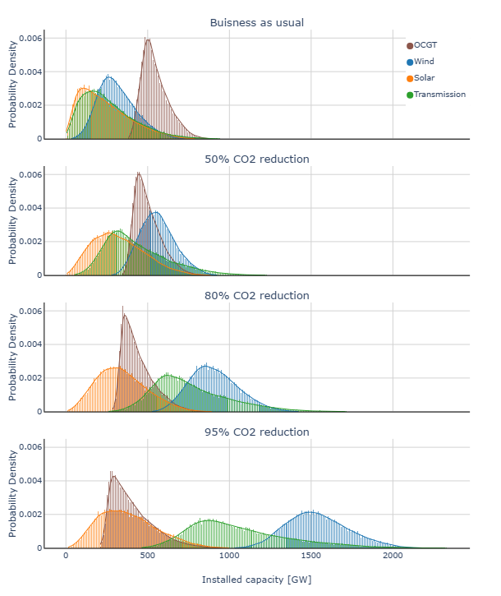
Results - MGA
4 Variables:
Wind, Solar, Gas (OCGT), Transmission
10% MGA slack
Large variance
Notes:
Pointe: Large variance

Slide 18
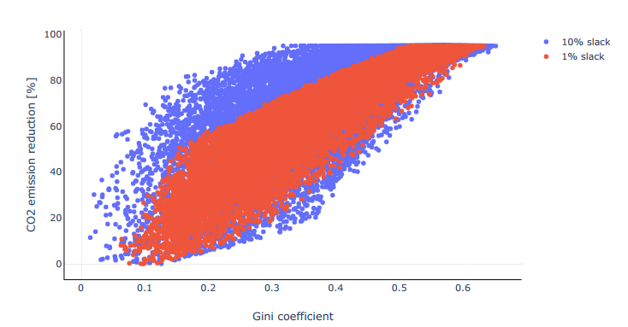
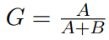
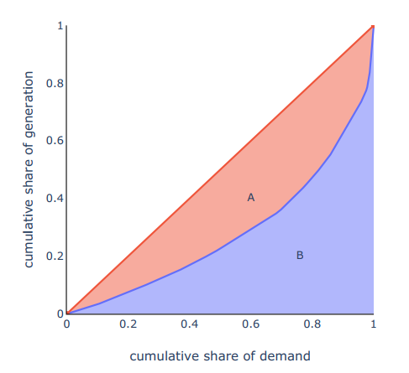
Results - MGA
Equality in energy production
Desire to be self-sufficient
Gini coefficient
Notes:
Pointe: Equality is expensive

Slide 19
conclusion
Method successfully developed
Converges towards full solution
Quantifies all near optimal solutions
Method capable of handling 7+ variables
Great variance in near optimal solutions at small variation in cost
Method can be used on any linear problem with large structural uncertainty

Slide 21
Discussion
Comparison of MGA methods
Limitations max 10 dim

Slide 22
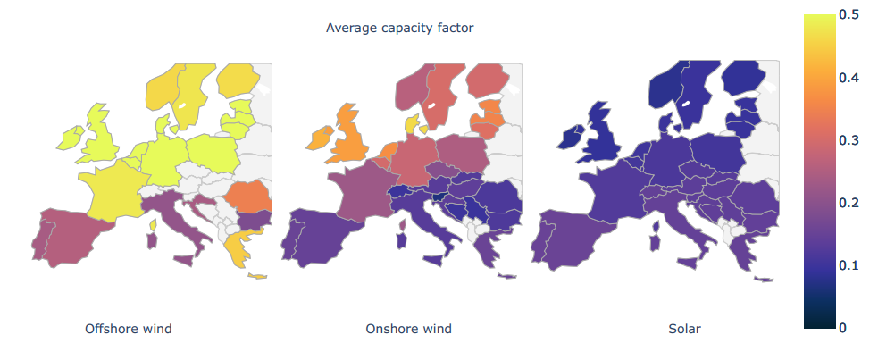
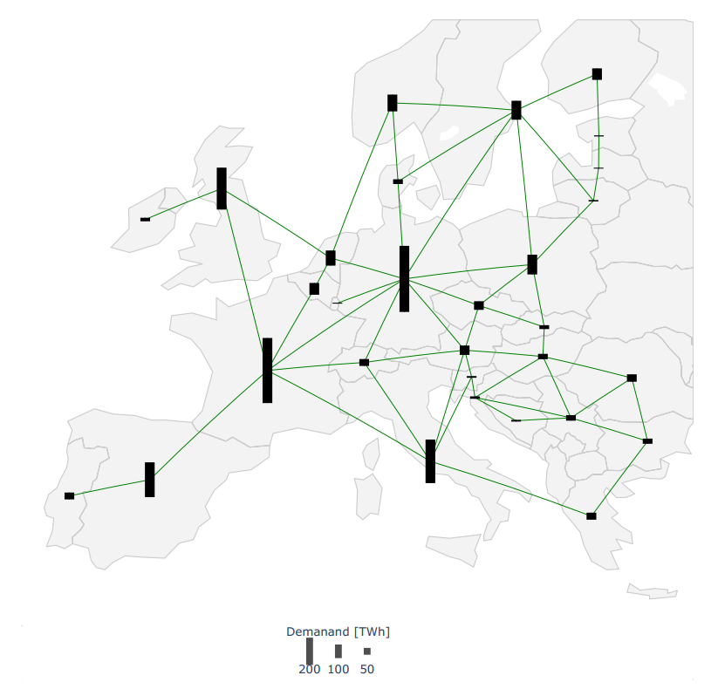
Model - constants
Average capacity factor
Summed electricity demand

Slide 23
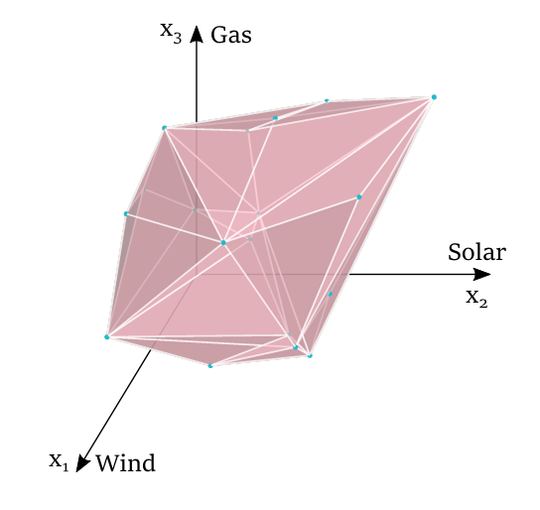
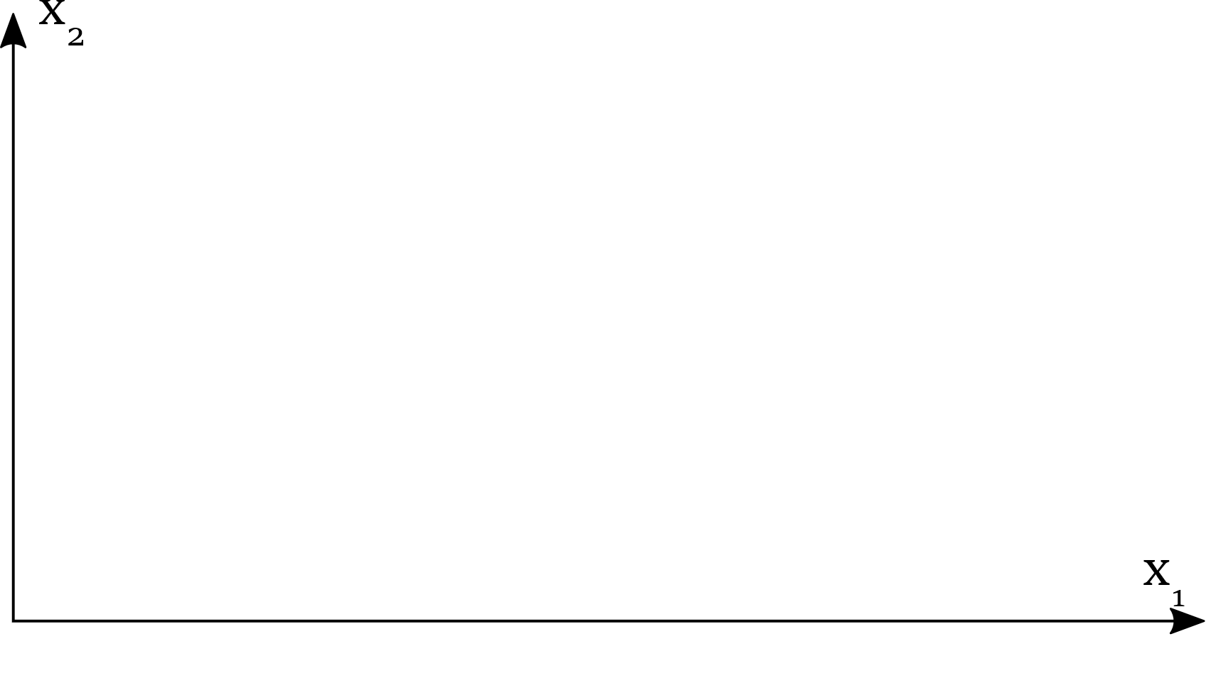
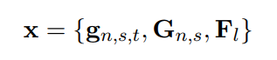
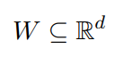

Decision space
Variables:
Decision space:
Constraints:
Feasible decision space:
Notes:
Pointe: Explain feasible space in n dimensions

Slide 24





Model
Minimize cost
Linear Constraints
Optimization
Simplex method
Barrier method
Notes:
Pointe: Model is linear

Slide 25





Model - constraints
Variables:
Power balance
Production limitations
Transmission limitations
Capacity limitations
CO2 constraint
Notes:
Linear

Slide 26
Summary
Model
Linear constraints
Data
Parametric and structural uncertainty
“True” solution located in inferior region
MGA method
Reducing dimensions
Finds all near optimal feasible solutions
Results
Large variance

Slide 27
Conclusion
A novel modeling to generate alternatives approach has successfully been developed
The method determines the convex hull containing all near optimal solutions

